Slide 1
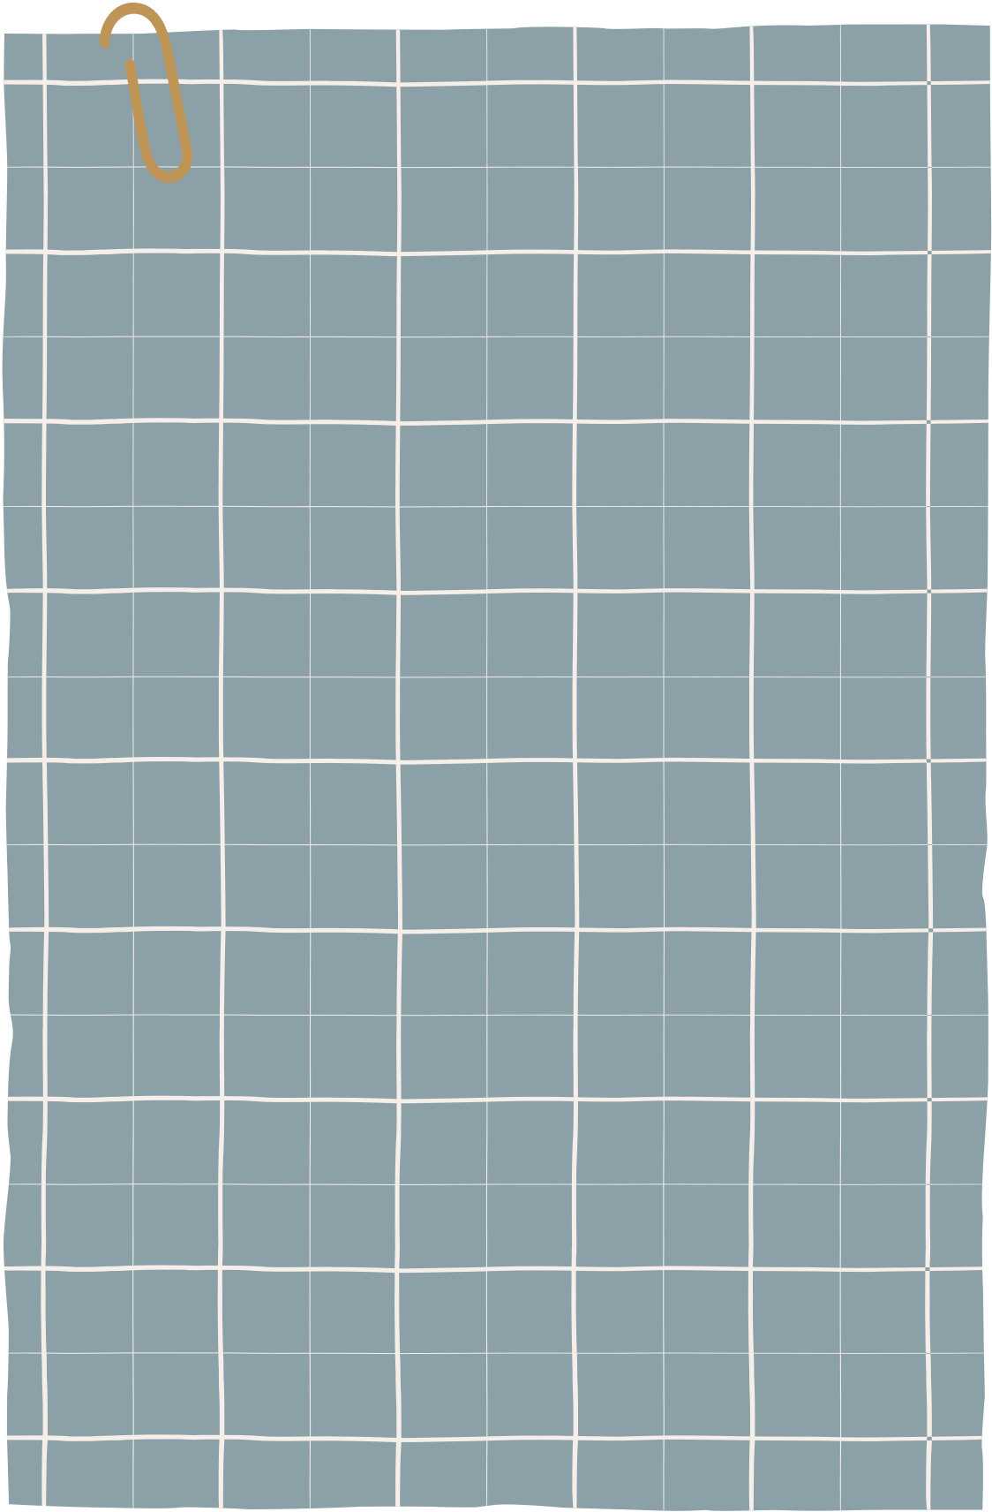




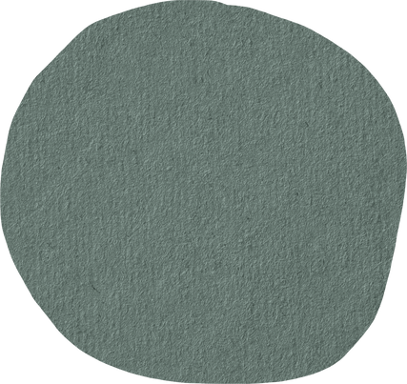
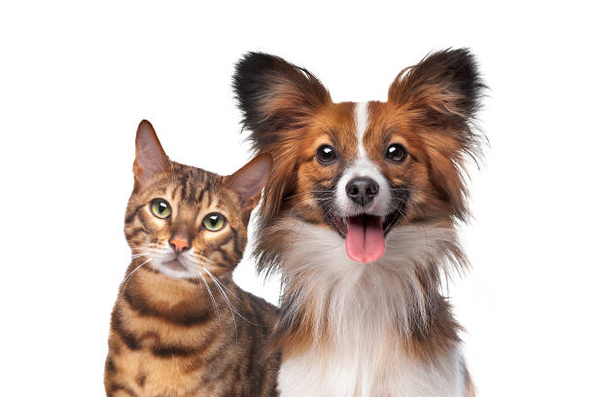
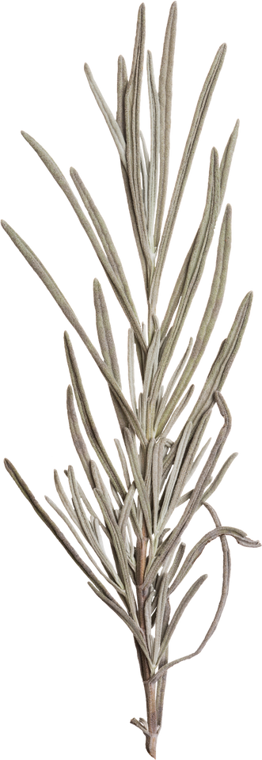
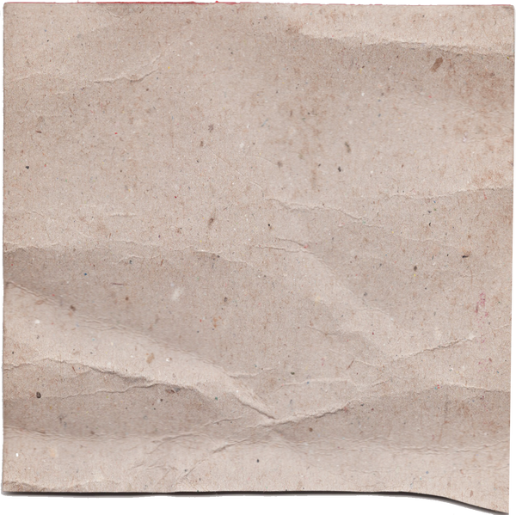
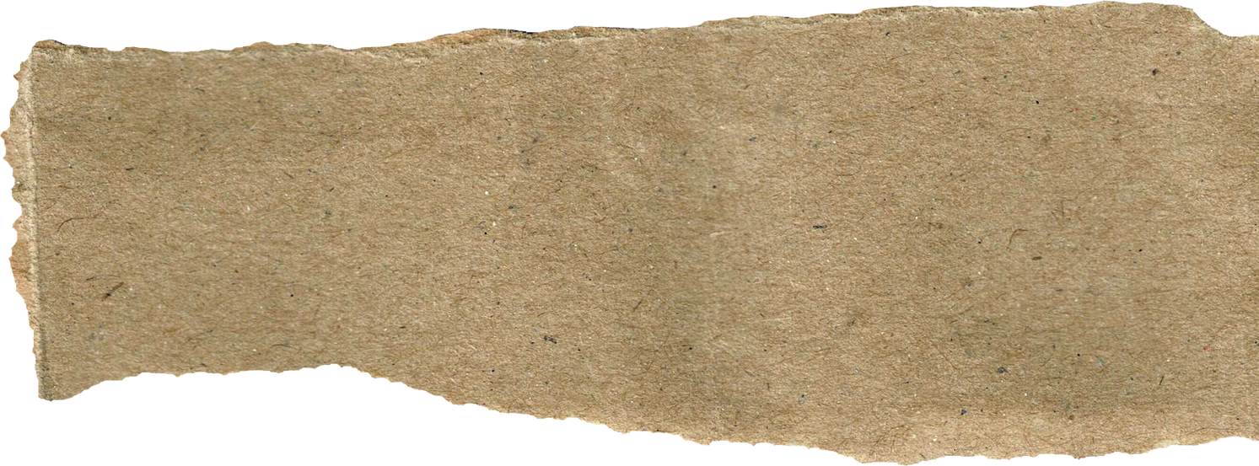
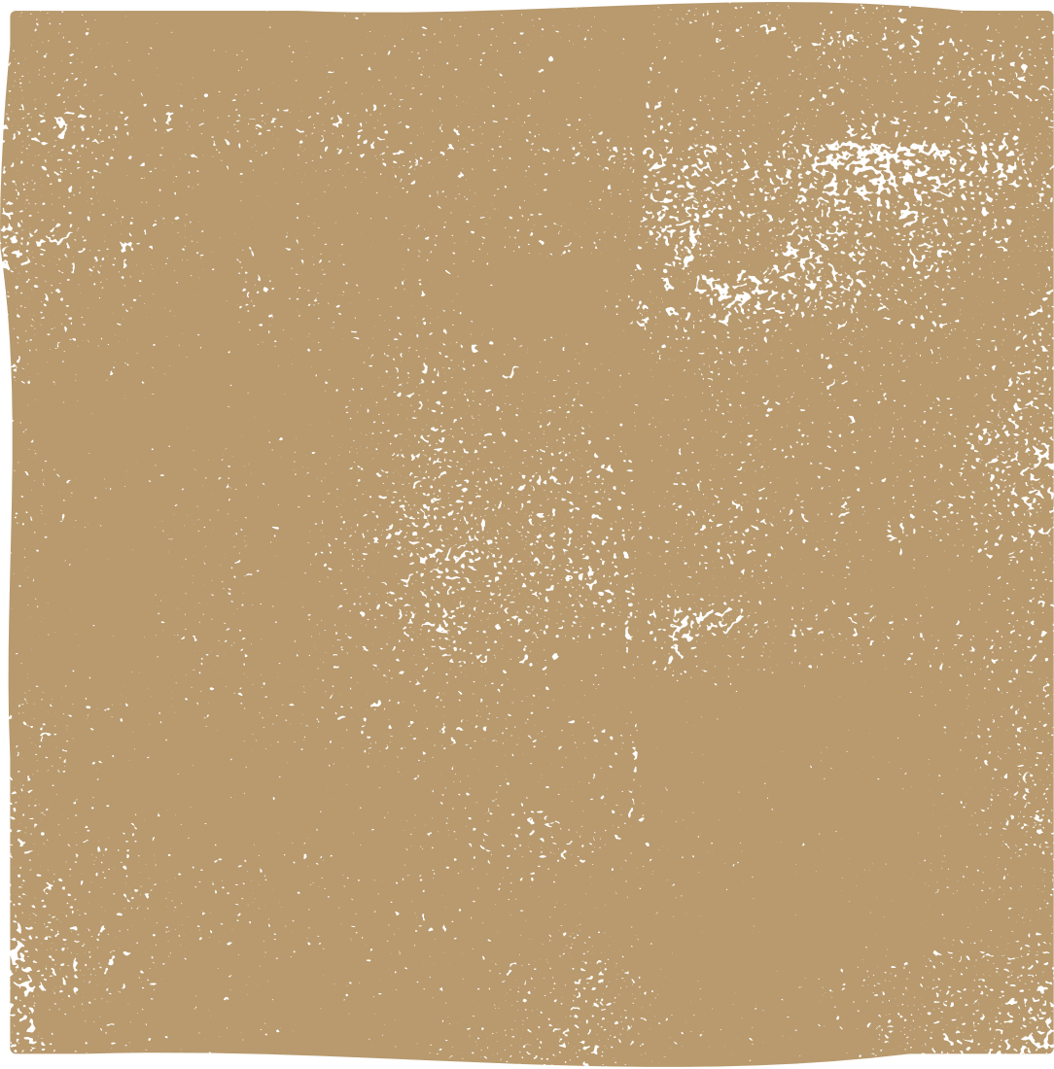
Dog vs Cat Classification
Data science project

Slide 2
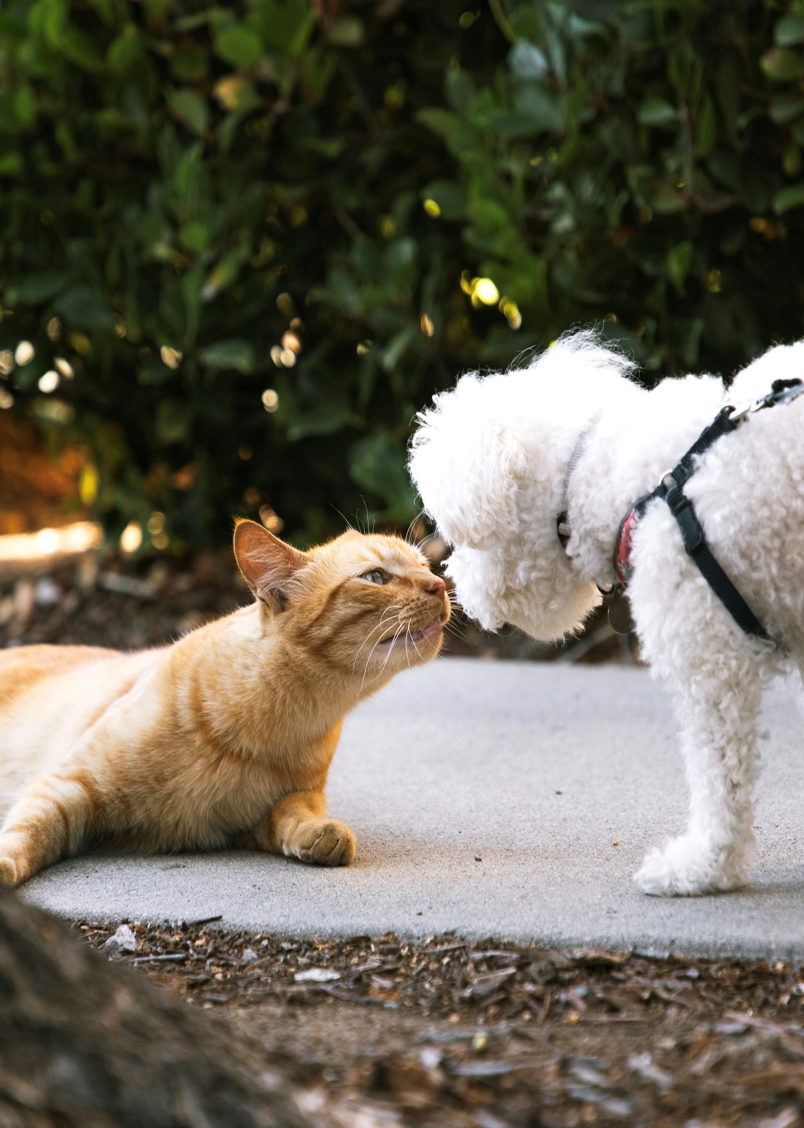

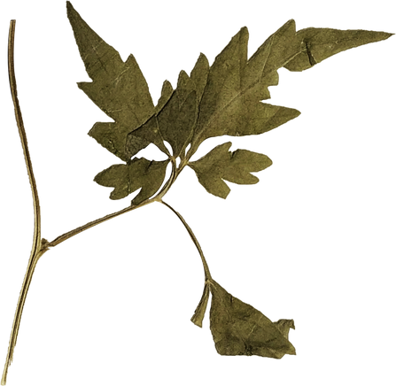
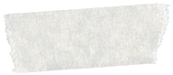
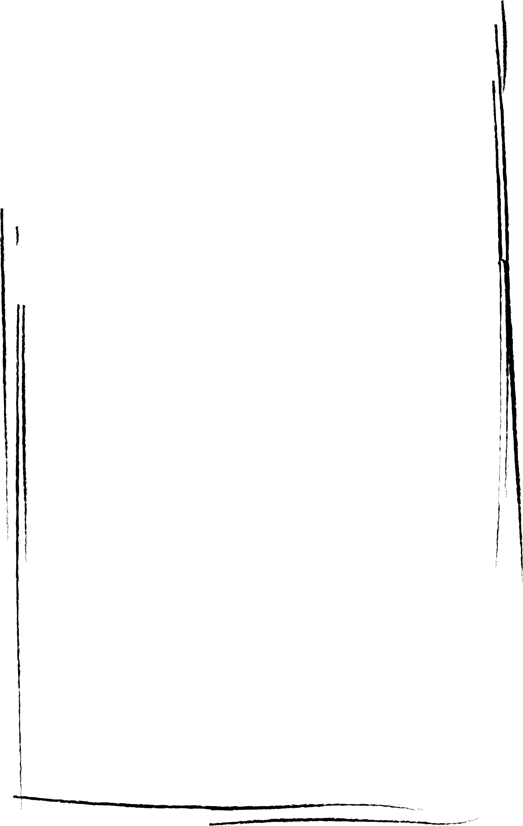
Agenda
Introduction
Problem Statement
Objective
Dataset Description
Data Preprocessing
Models
Pretrained Model
Custom CNN Model
Model Training & Evaluation
Results & Conclusion

Slide 3



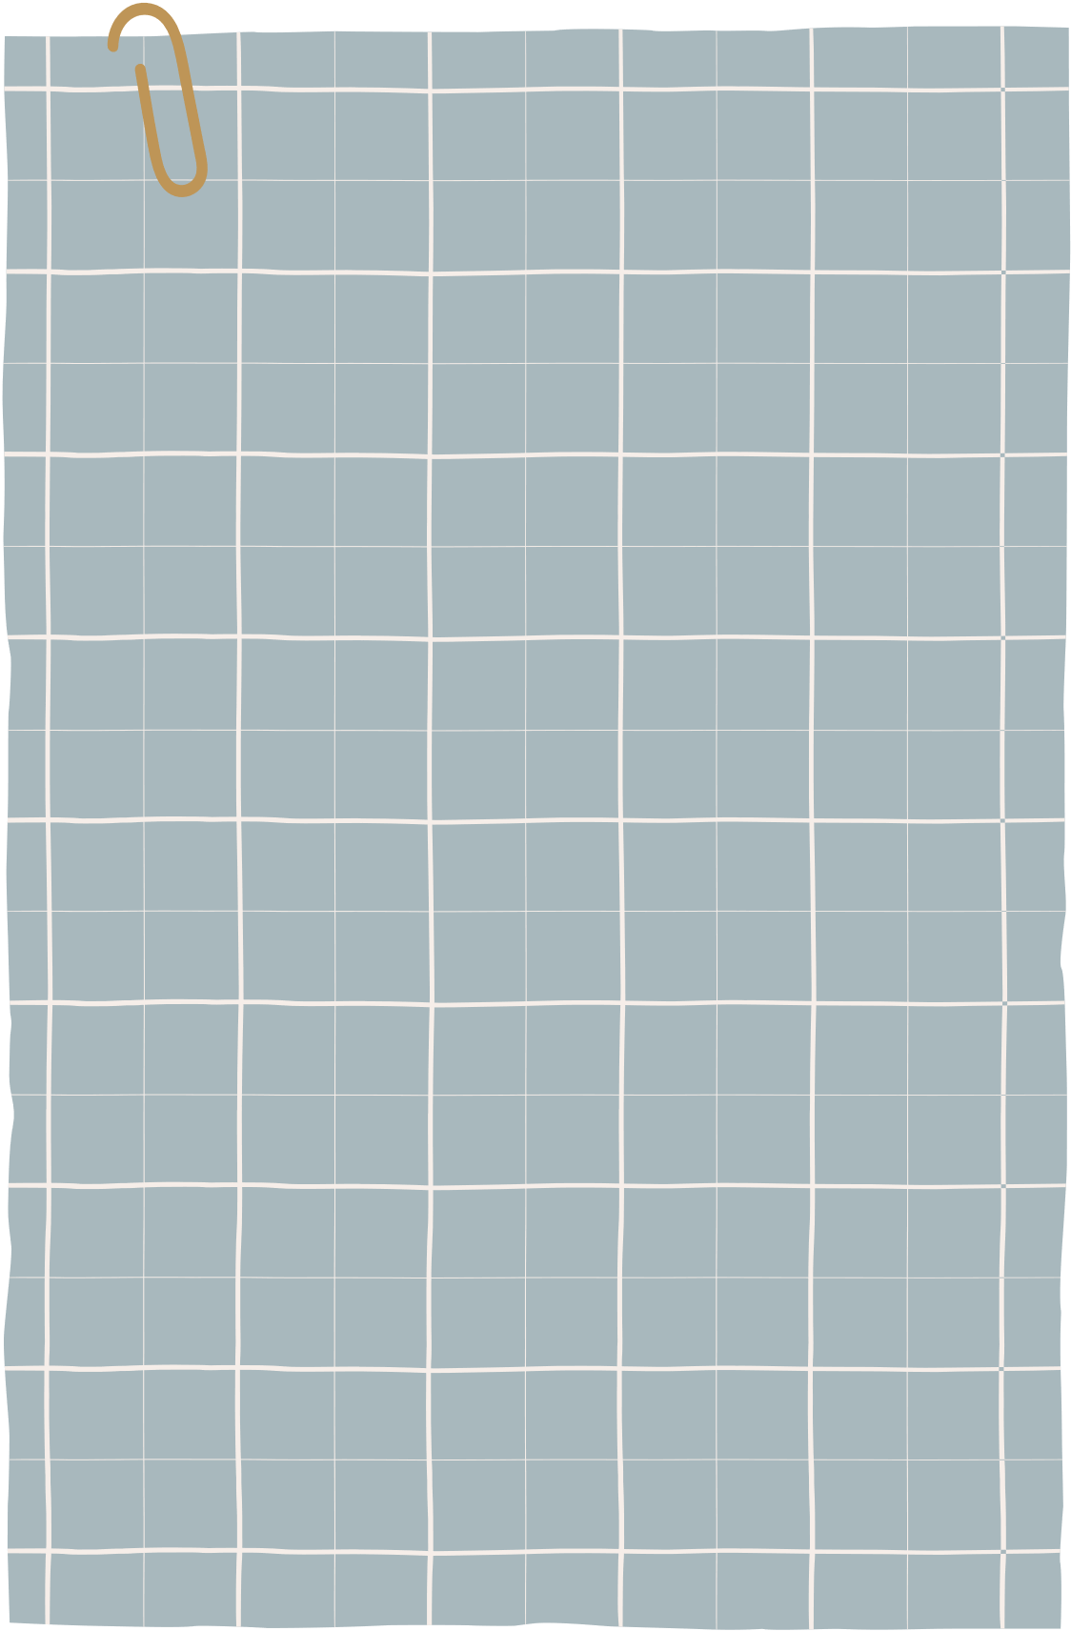
Introduction
i
Objective
Problem statement
Develop a robust image classifier
Choose a pre-trained model for transfer learning.
A custom Convolutional Neural Network (CNN) built from scratch.
Compare the performance of the two models using metrics like accuracy, precision, recall, F1-score, and confusion matrices.
The task is to classify images into two categories: cats and dogs. This is a supervised learning problem that involves image classification using deep learning techniques.

Slide 4
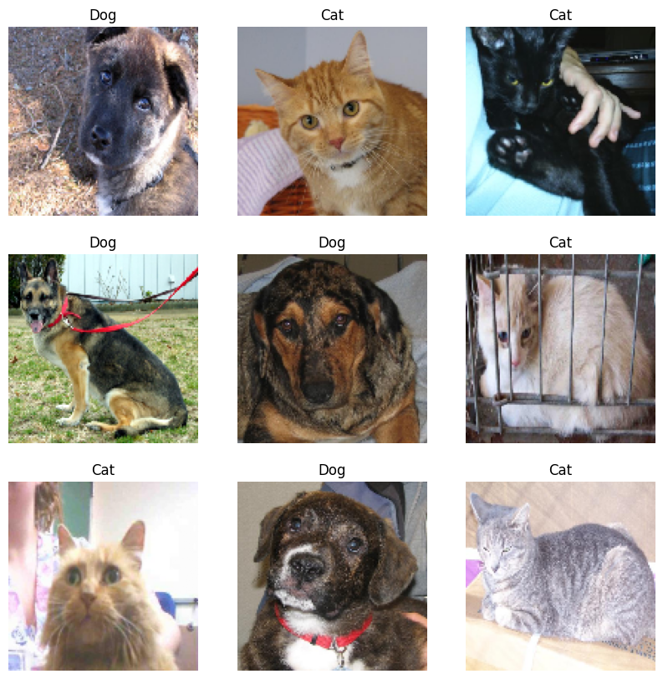
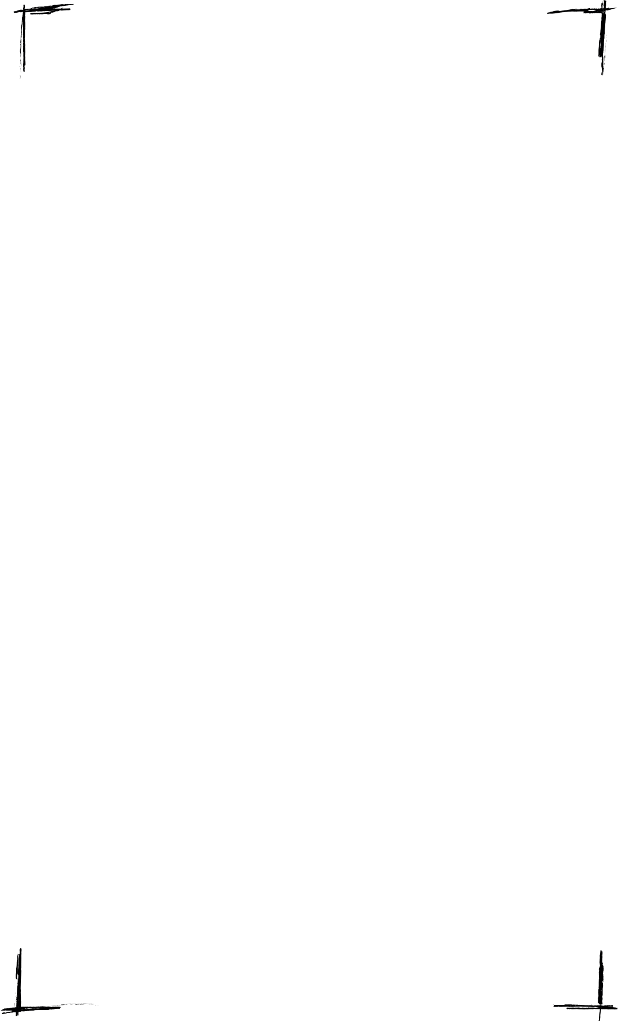
Dataset
Source
The dataset, sourced from Microsoft's official "Cats vs. Dogs" dataset.
Description
Each image is labeled based on its folder (0 for cat, 1 for dog).
Extract 19000 photos from the original data (9500 image of cats and 9500 images of dogs).
Images were resized to 128x128 pixels for uniformity.
Normalized pixel values to the range [0, 1] for faster convergence.
Samples of data

Slide 5

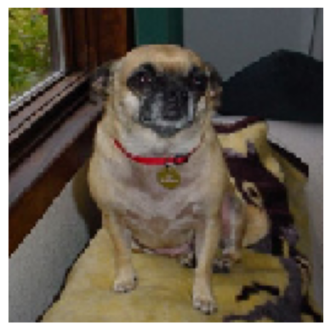
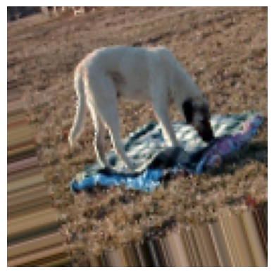
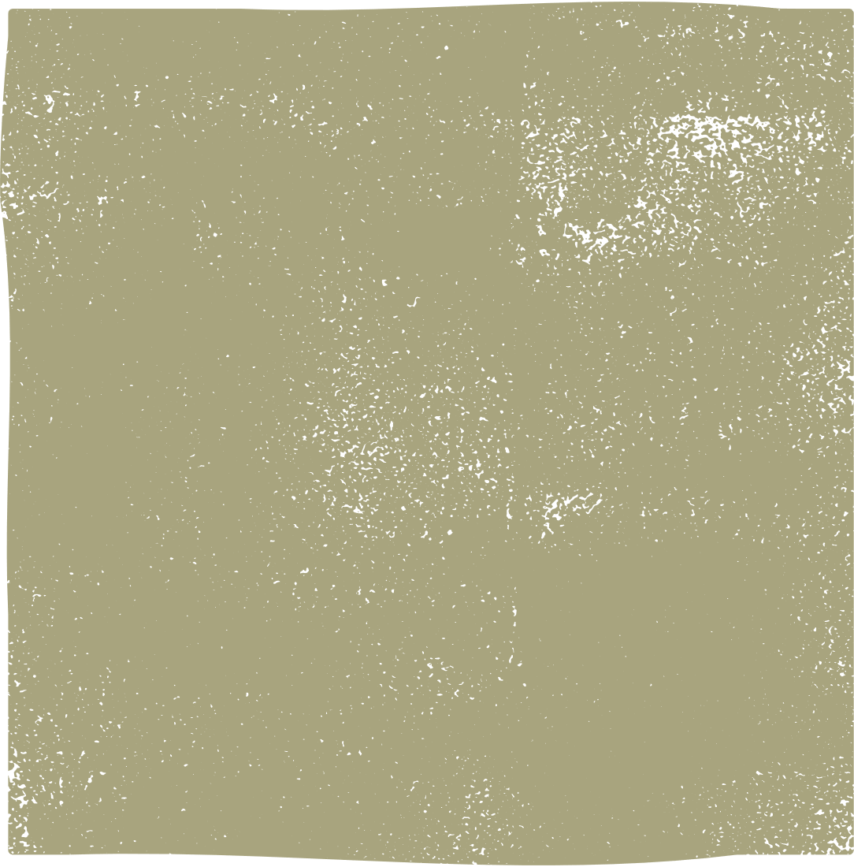

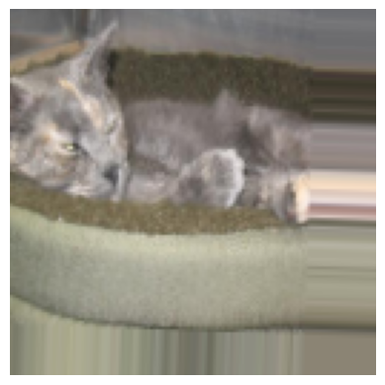
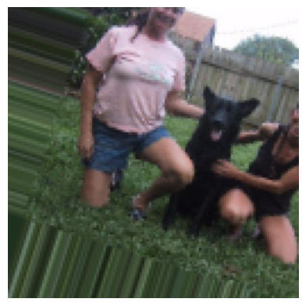
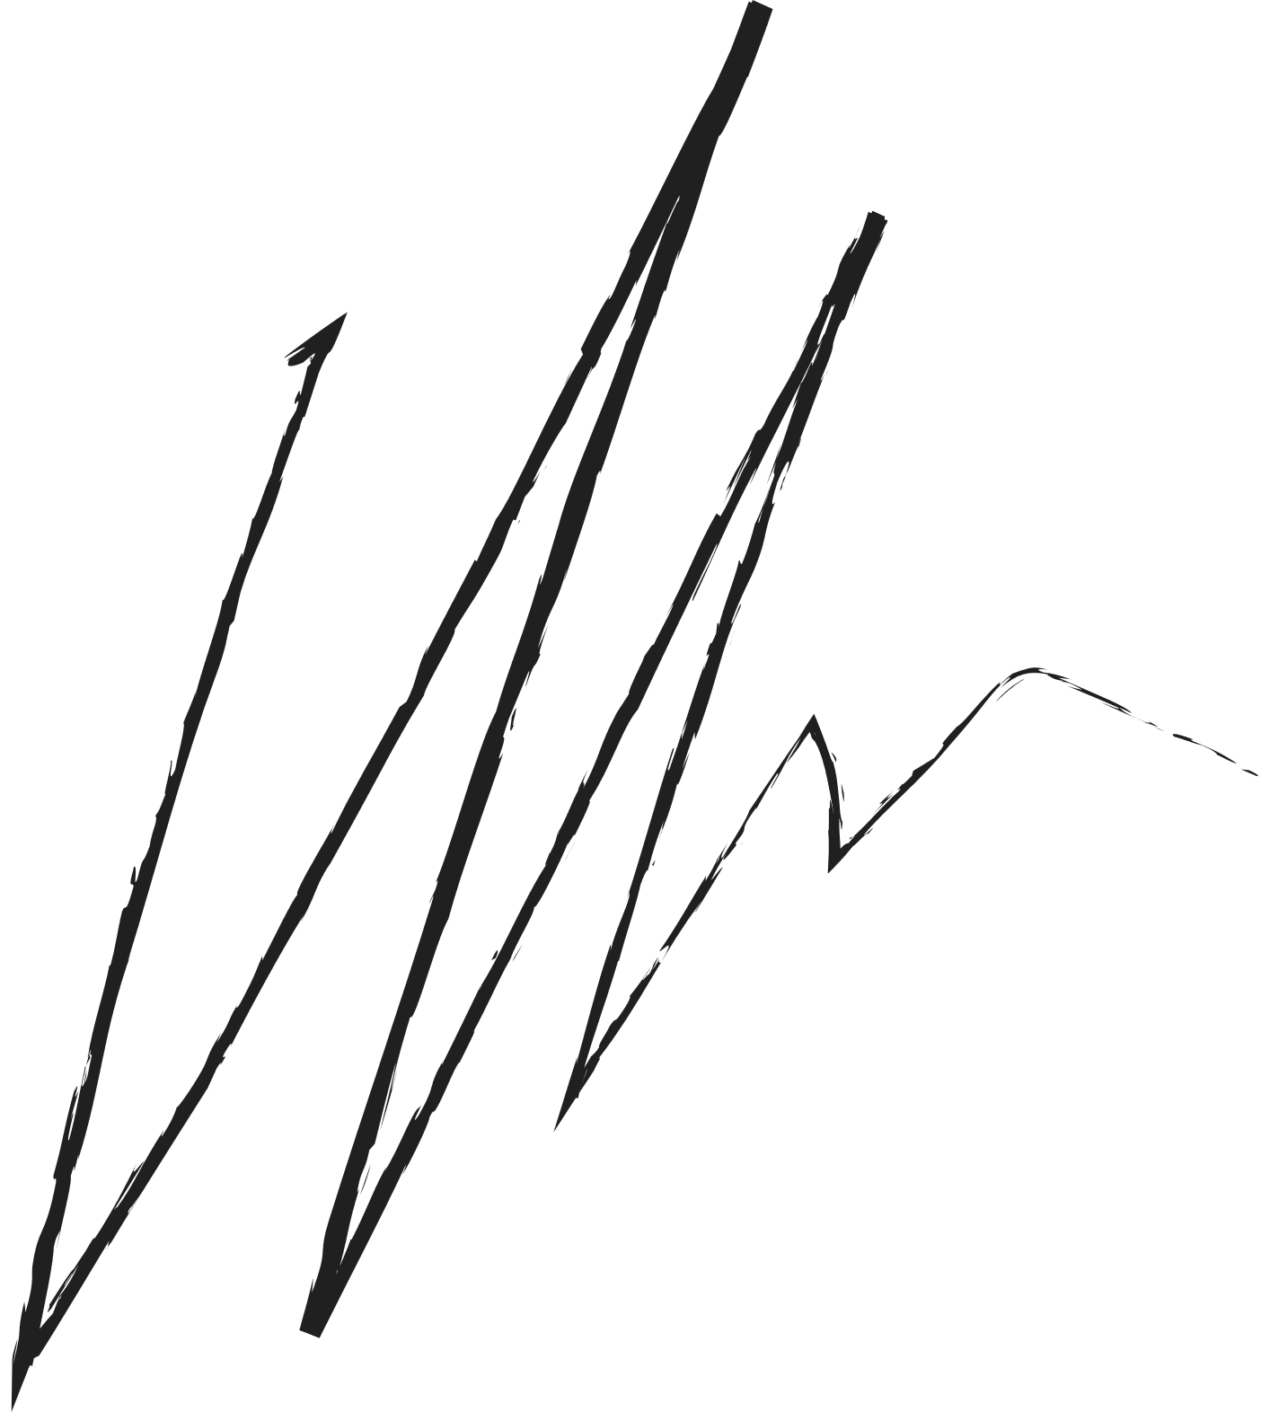
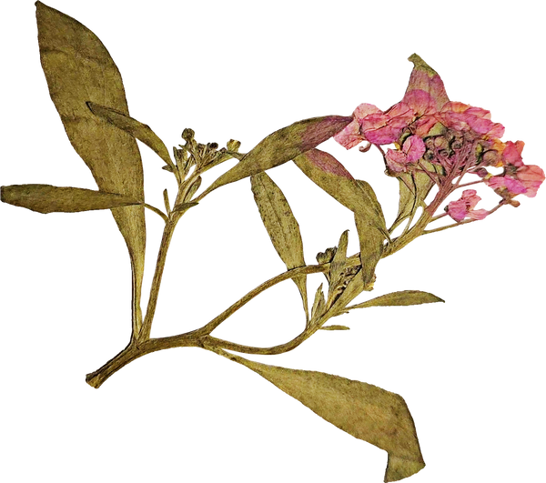
Pre-processing
Data augmentation
Techniques used
Data after augmentation
Rotation: Images are randomly rotated within a range of 20 degrees.
Purpose Helps the model learn to recognize objects in various orientations.
Width Shift: Images are randomly shifted horizontally by up to 20% of the total width.
Purpose Simulates variations in object positioning within the frame.
Height Shift: Images are randomly shifted vertically by up to 20% of the total height.
Purpose Similar to width shift, this helps the model to be invariant to vertical positioning changes.

Slide 6
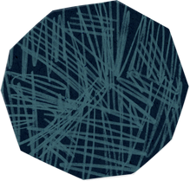
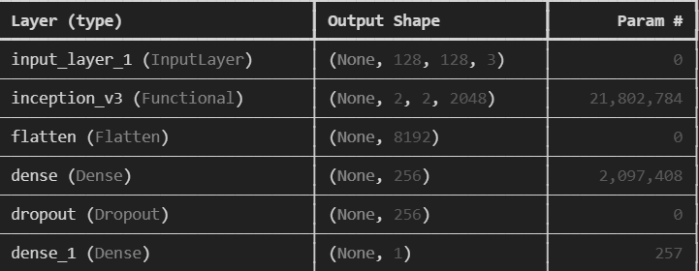
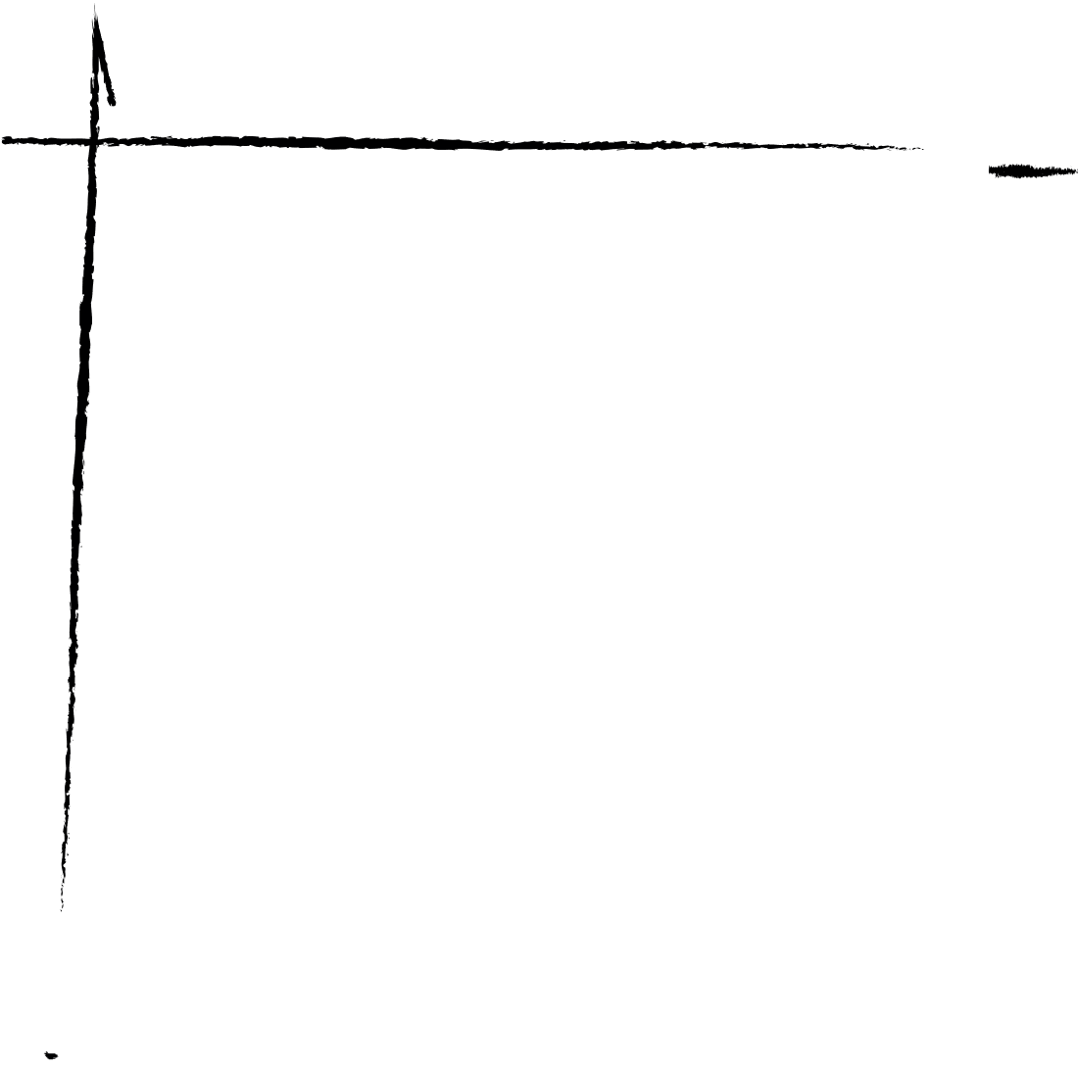
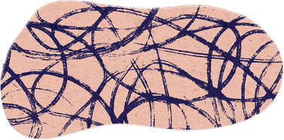
models
Pre-training model”Lnception16”
WHY USE?
InceptionV3 is trained on ImageNet, which contains millions of images across thousands of classes, providing a strong feature extraction capability. Custom Layers:
Flatten layer.
Dense layer with 256 neurons and ReLU activation.
Dropout (50%) for regularization.
Dense output layer with Sigmoid activation.
Frozen Layers: Pretrained layers not trainable.
Trainable Parameters: ~2.1M

Slide 7
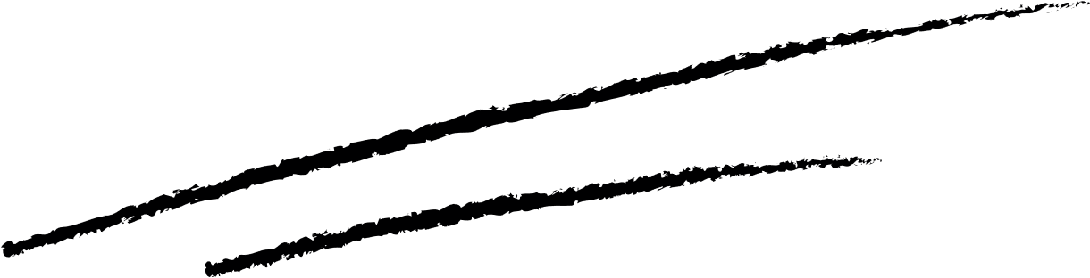
Models Cont.
Custom CNN model
architecture
Optimizer
Adam with a learning rate of 1e-4.
Early stopping
Convolutional Blocks:
3 blocks with increasing filters (32, 64, 128).
Each block contains Conv2D, BatchNormalization, and MaxPooling layers.
Fully Connected Layer:
512 neurons with ReLU activation.
Dropout layer with a rate of 0.5 to prevent overfitting.
Output Layer:
Sigmoid activation for binary classification.
Monitored validation loss with patience of 5 epochs.
Reduce learning rate on plateau
Halved learning rate if validation loss does not improve for 3 epochs.
Total parameters
12.94M

Slide 8
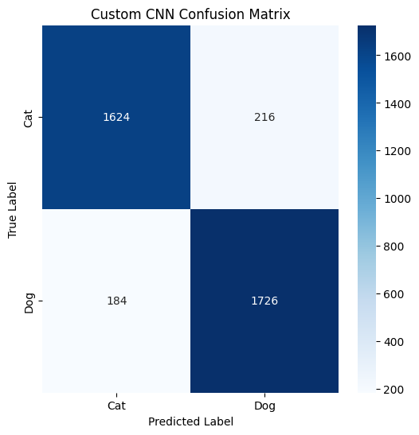

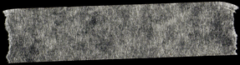
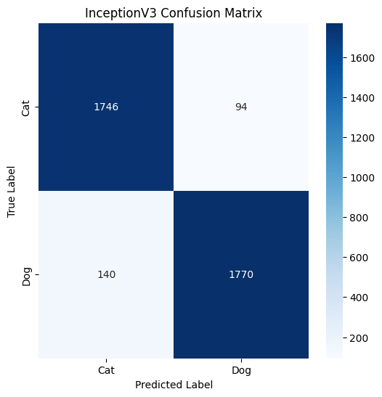
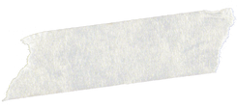
Model Training & Evaluation
Confusion Matrix
Split Data into:
70% for Training
15% for Validation
15% for Testing
Both models were trained using the training data, with validation data used for monitoring performance during training.
In Custom CNN model use Early stopping callbacks were added to prevent overfitting.
InceptionV3 achieve accuracy 94%.
Custom CNN model achieve accuracy 89.33%.

Slide 9
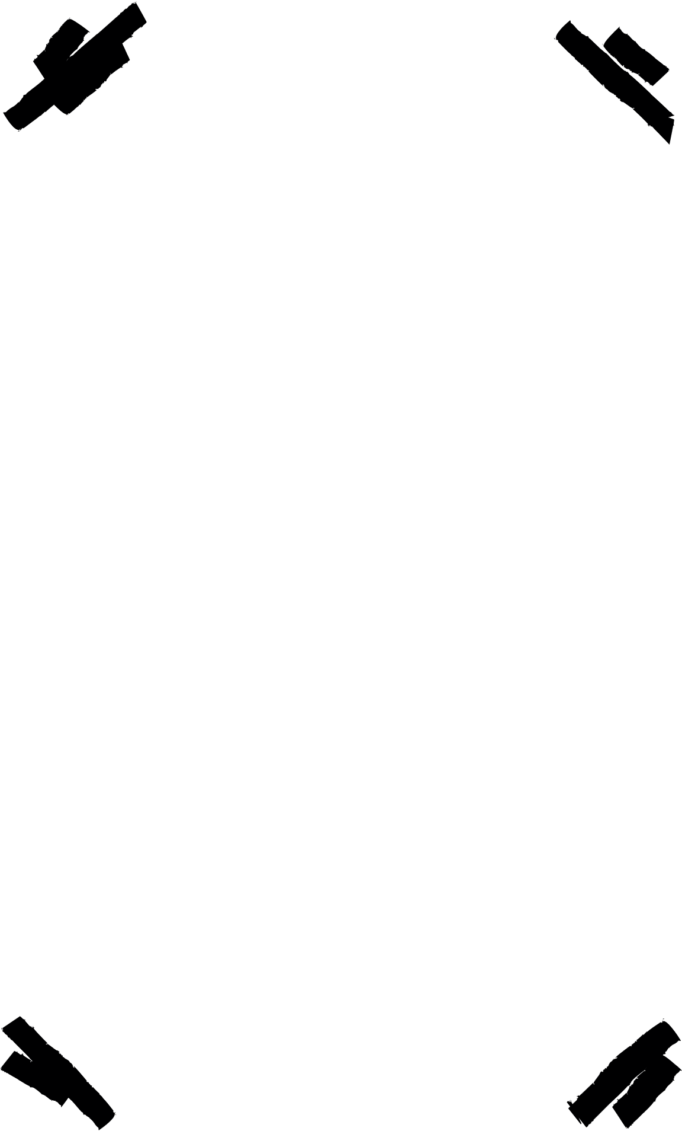
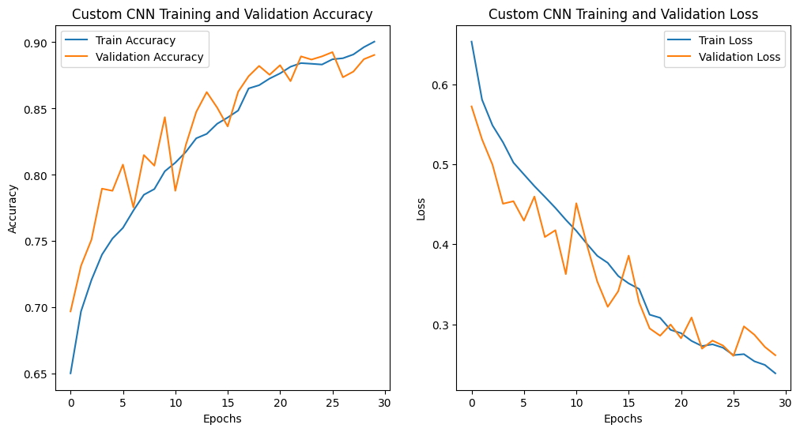
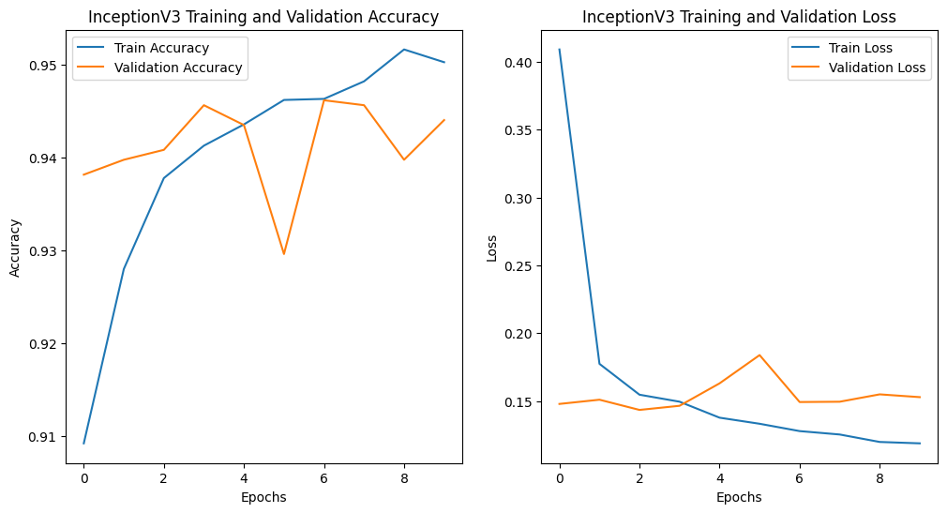
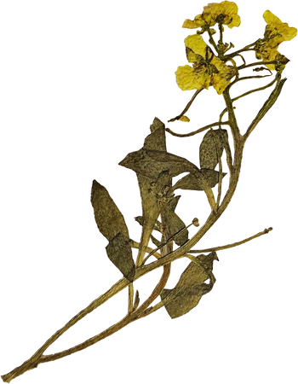
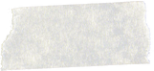
Result & Conclusion
Plot Training and validation accuracy
The pretrained Inception16 model was more effective due to its feature extraction capabilities.
The custom CNN model performed well but required careful tuning and more computational effort.
Conclusion

Slide 10
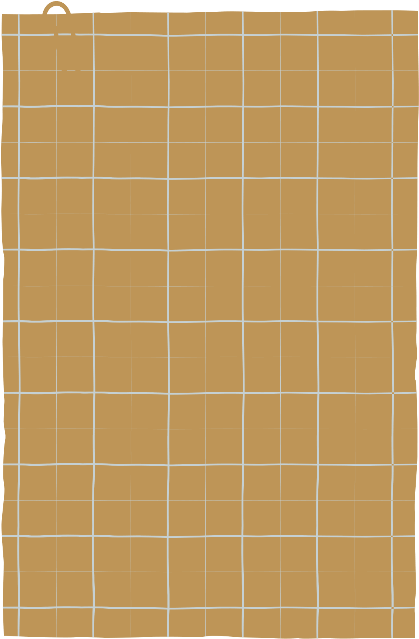
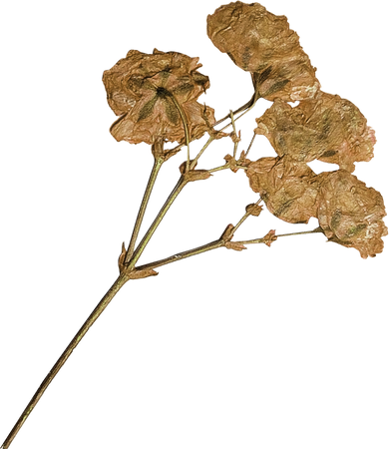
Team members
Sondos Ahmed Abdallah Mohamed
Sohaila Mohamed ahmed Zaki
Nada Mohamed shahat Ali
Rahma Alaa al-din Youssef
Sara Abdallah abbas ElSayed
Aya fakri Mahmoud

Slide 11
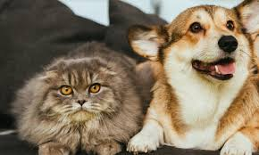
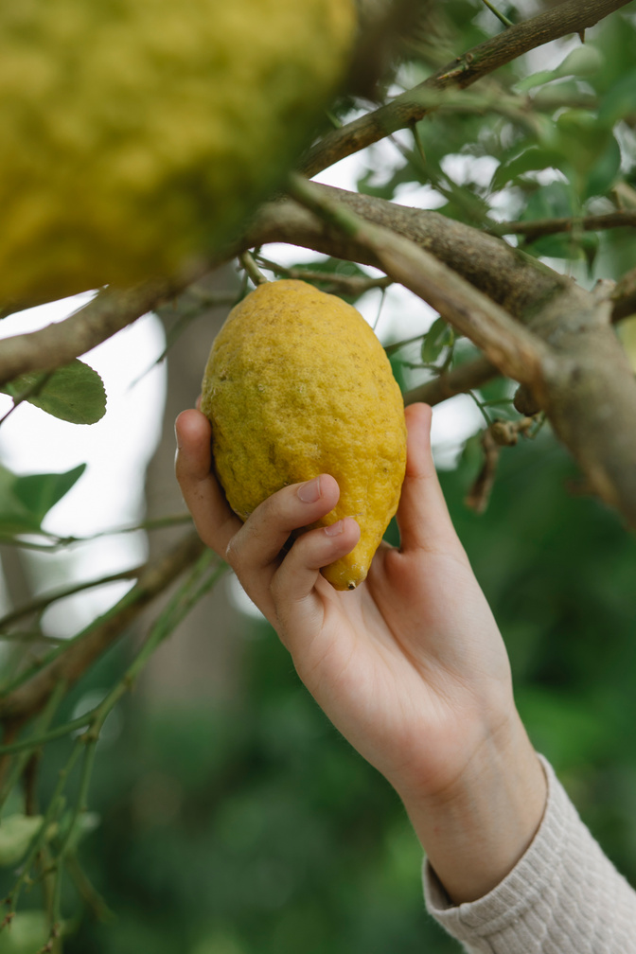

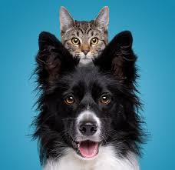
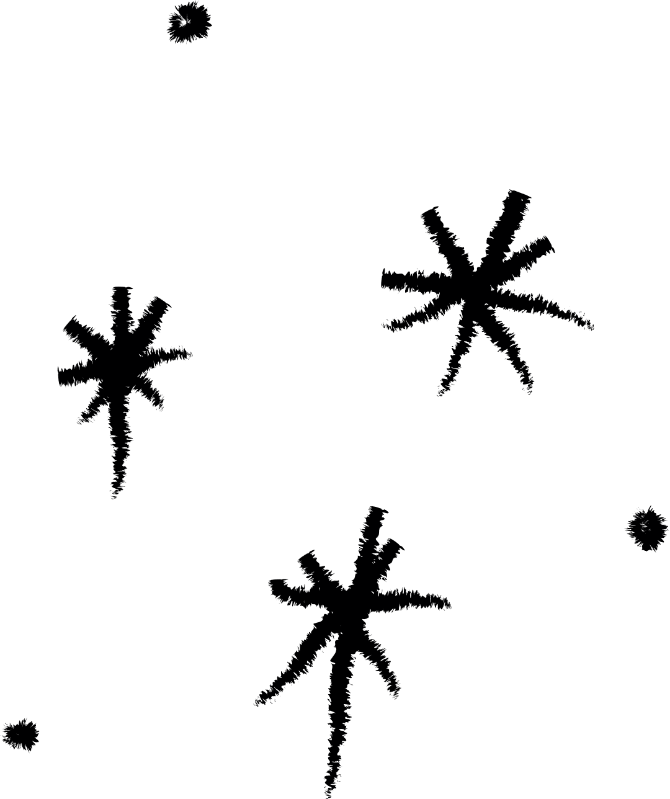

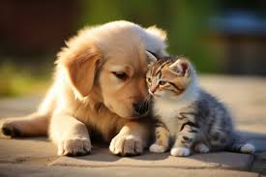
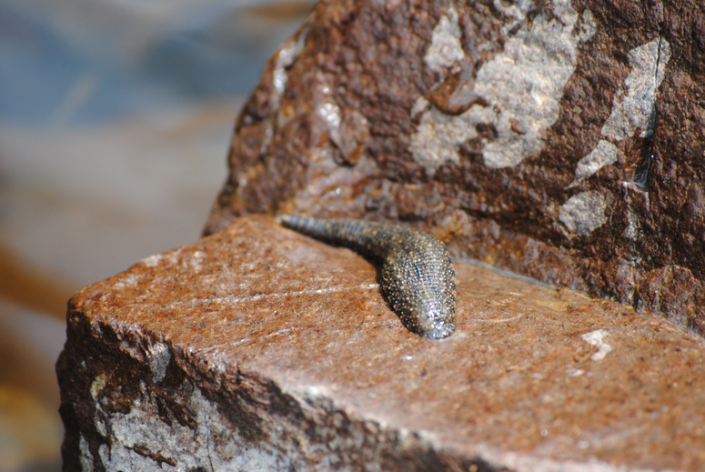


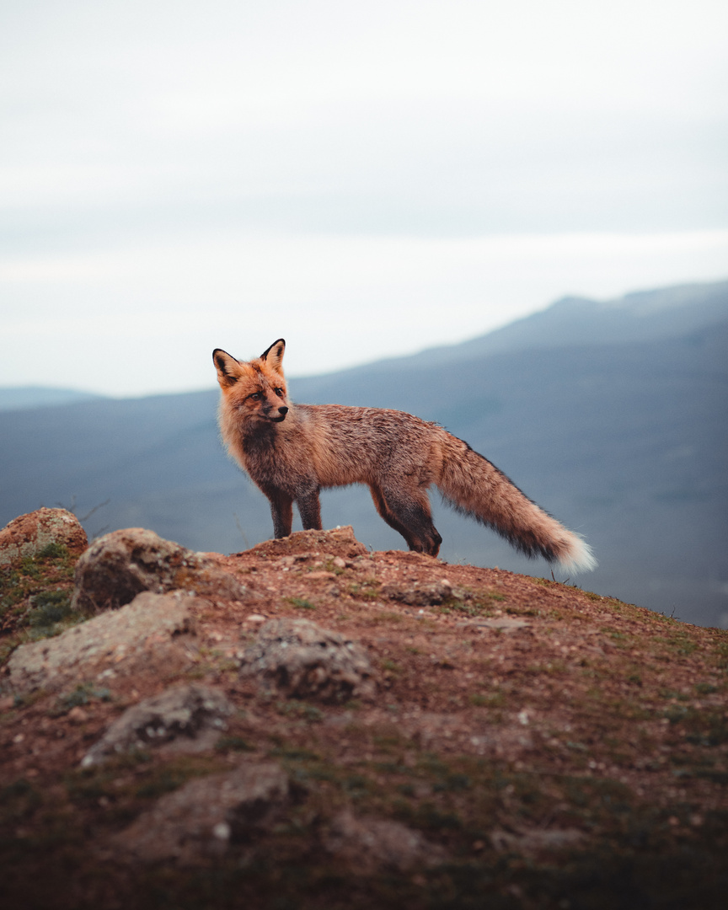
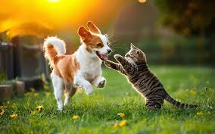
Thank you!

